Slide 1

Chandigarh University Uttar Pradesh
School of Computer Science & Engineering
Semester III
Python Programming
Course Code: 25 CSH-214
Faculty Name: Prateek Singhal

Slide 2
UNIT 1 Lecture 2 Topics to be Covered
1. Introduction to Python
2. History
3. Evolution of Python in engineering
4. Applications in AI, Biomedical, Engineering, IoT, Robotics, Data
Science

Slide 3
History of Python
1. Python was developed by Guido van Rossum in 1989
2. Officially released in 1991
3. Named after the British comedy show “Monty Python’s Flying Circus”
4. Designed with the philosophy:
Simple syntax
Readable code
Rapid development

Slide 4
Need for Python Programming
Python works on different platforms (Windows, Mac, Linux, Raspberry Pi, etc).
Python has a simple syntax similar to the English language.
Python has syntax that allows developers to write programs with fewer lines than some other programming languages.

Slide 5
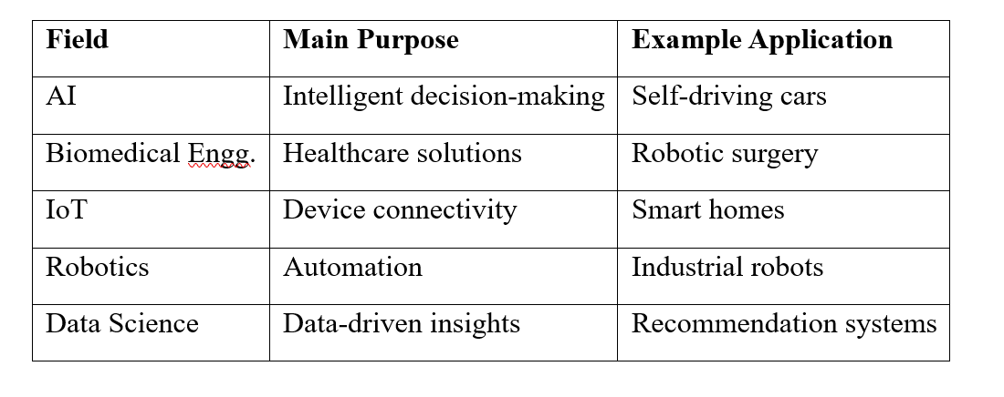
Applications of Python in various domains

Slide 6
Applications of Python in Biotechnology
Area | Key Applications
Bioinformatics | Analyzing DNA and protein sequences, gene classification, sequence alignment, and genome analysis
Data Science | Handling large biological datasets, automating laboratory workflows, and creating meaningful visualizations
Drug Discovery | Modeling molecular properties, predicting drug solubility (LogS), and simulating drug interactions
Machine Learning | Building predictive models for protein structure prediction and gene classification

Slide 7
Book References:
https://bugs.python.org/file47781/Tutorial_EDIT.pdf
https://assets.openstax.org/oscms-prodcms/media/documents/Introduction_to_Python_Programming_-_WEB.pdf
Video Lecture:
https://www.youtube.com/watch?v=nLRL_NcnK-4
Websites:
https://www.anaconda.com/download

Slide 8
Thanks

